Slide 1
Spatio-Temporal Analysis of Flash Flood Events in Texas
Stat 647 Final Project
Fall 2021
Presented by:
Rohan Singh Wilkho; PhD-Civil Engineering, MS-Computer Science
Macson Ogieriakhi; PhD-Agricultural Economics

Slide 2
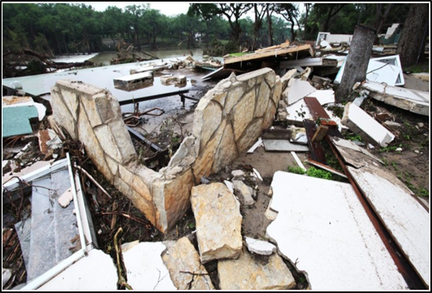
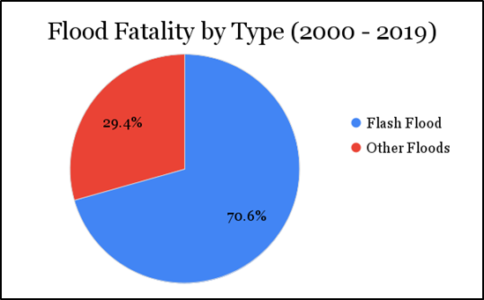
Flash Flooding
Motivation
Methodology
Results & Discussion
Conclusion
Rapid onset (usually under 6 hours)
Example (Flash flooding of Blanco River, Wimberley TX, May 2015): River experienced rise of 20 feet in one hour; 10-13 inches of rain in 4-6 hour period; Damages in excess of $100 million.
Small spatial scale (e.g., neighborhood)
High water flow velocity
Lethal (2000-2019)
71% of all flood-related fatalities
73% of all flood-related injuries
72% of flood-related economic losses
Flash flood destroys property in Wimberley, TX (LA Times)
NOAA Storm Events Database

Slide 3
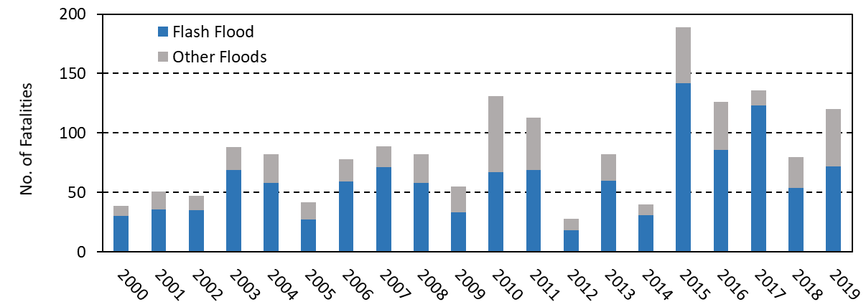
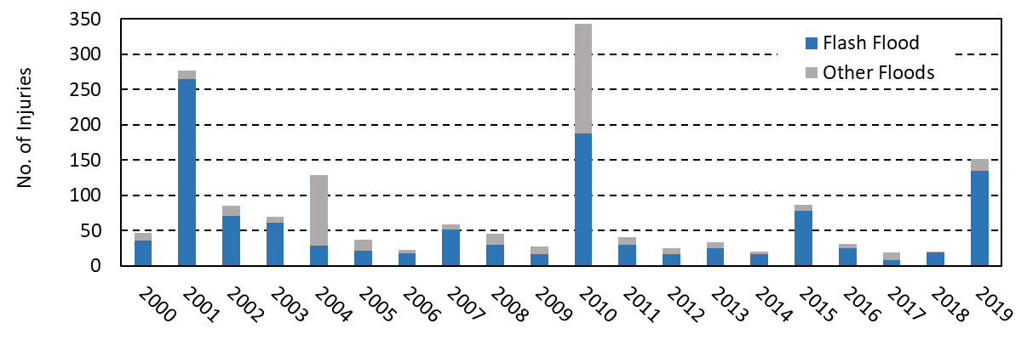
Flash Flooding
Motivation
Methodology
Results & Discussion
Conclusion
Fig: Flood Fatalities v/s Years
Source: NOAA Storm Events Database
Fig: Flood Injuries v/s Years

Slide 4
Flash Flooding
Motivation
Methodology
Results & Discussion
Conclusion
Despite being so harmful, flash flooding phenomenon is not very well understood: Need to analyze past events.
Flash flooding frequency and impacts to rise with changing climate and urbanization: Targeted intervention is necessary.
Solution: Use past records to identify regions most susceptible to flash flooding - Spatial clustering.
Focus on Texas.

Slide 5
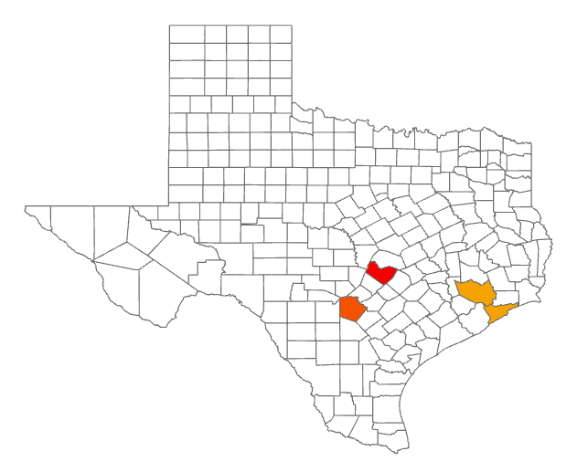
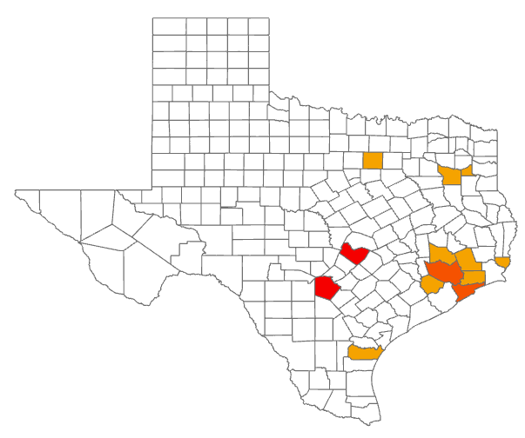
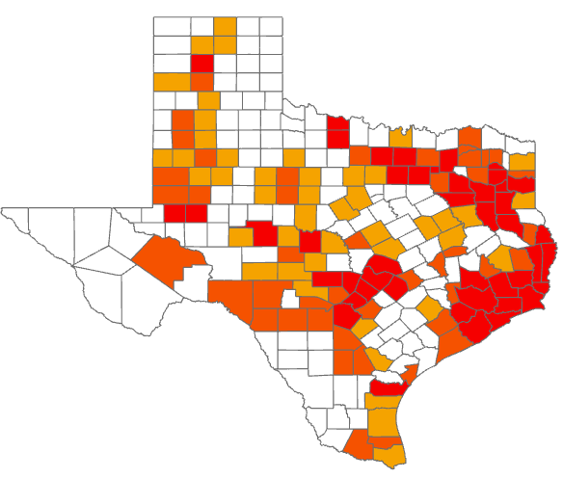
Flash Flooding
Motivation
Methodology
Results & Discussion
Conclusion
Why is spatial clustering required?
Equal Interval distribution
Natural Breaks distribution
Quantile distribution
It identifies values that are not random and that are statistically significantly!

Slide 6
Flash Flooding
Motivation
Methodology
Results & Discussion
Conclusion
Data:
NOAA Storm Events Database (2010-2019): Each data record is a past flash flood event.
Flash flood events in Texas at:
County Level.
R Package used: rflexscan (Flexible Spatial Scan Statistic)
Provides function and classes to analyze spatial count data
Spatial Clustering
Tests whether spatial count data is randomly distributed over space (Significant clusters)

Slide 7
Flash Flooding
Motivation
Methodology
Results & Discussion
Conclusion
Step 1: Flash Flood (FF) data for 10 years: 2010 - 2019.
Step 3: Normalize the FF count with the County area.
Step 5: Use the rflex package to perform Spatial Clustering.
Step 7: Visualize results.
Step 2: Aggregate FF data at County levels for the 10 years.
Step 4: Define Neighborhood structure (Adjacency / Distance-based).
Step 6: Select the most significant clusters (p<0.05)

Slide 8
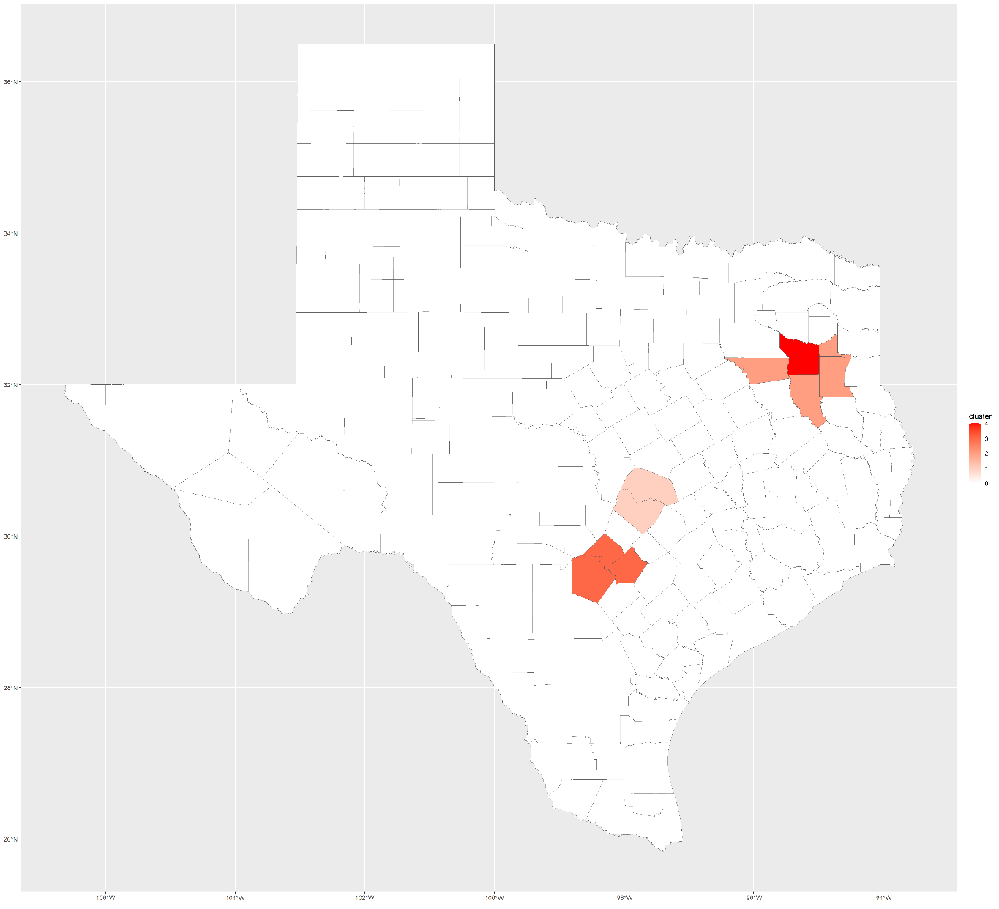
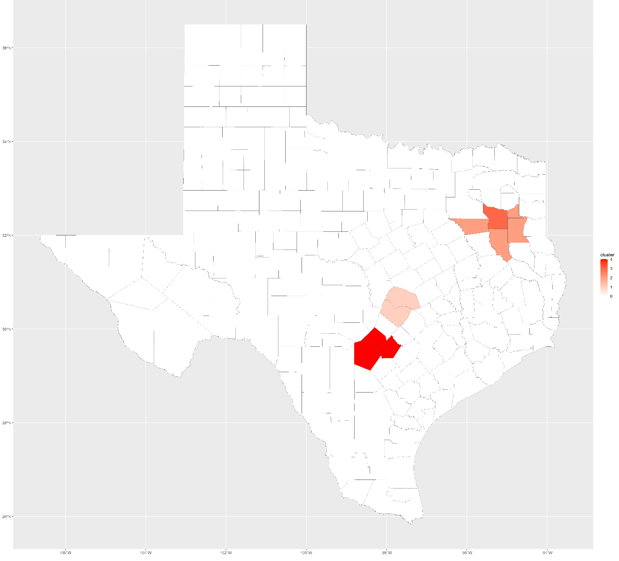
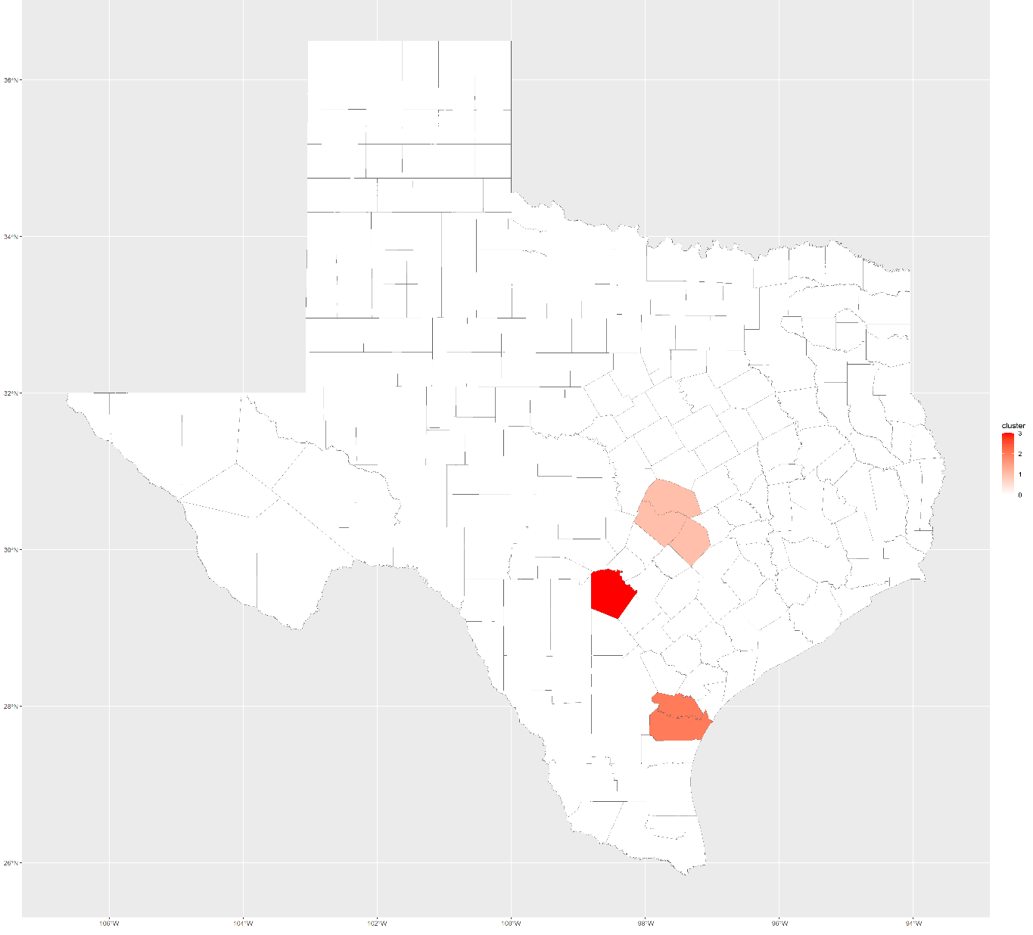
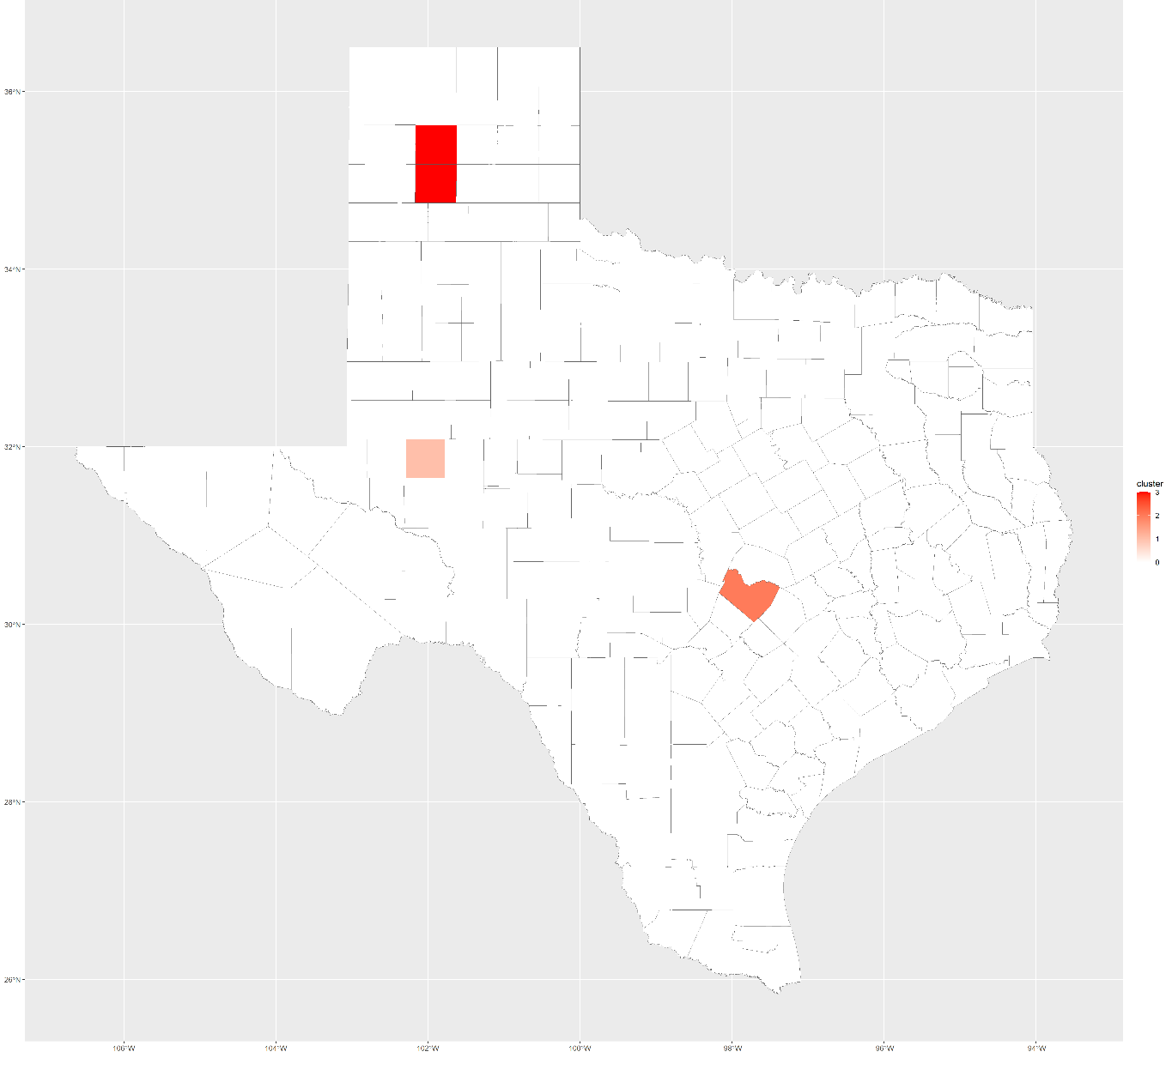
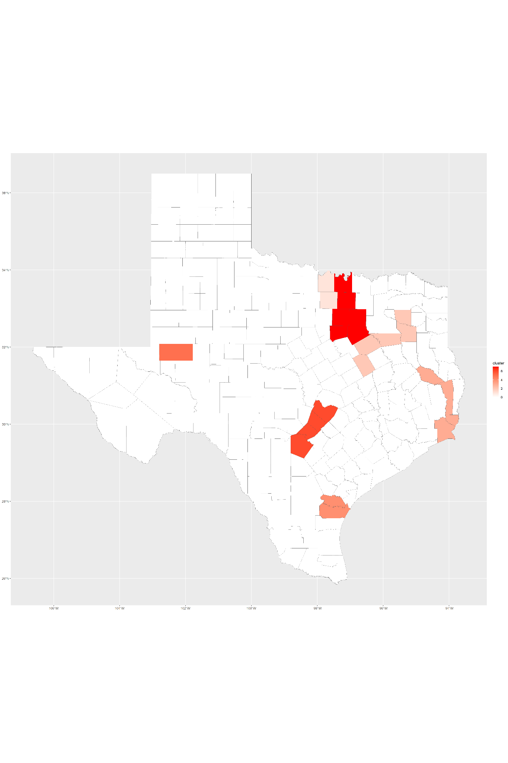
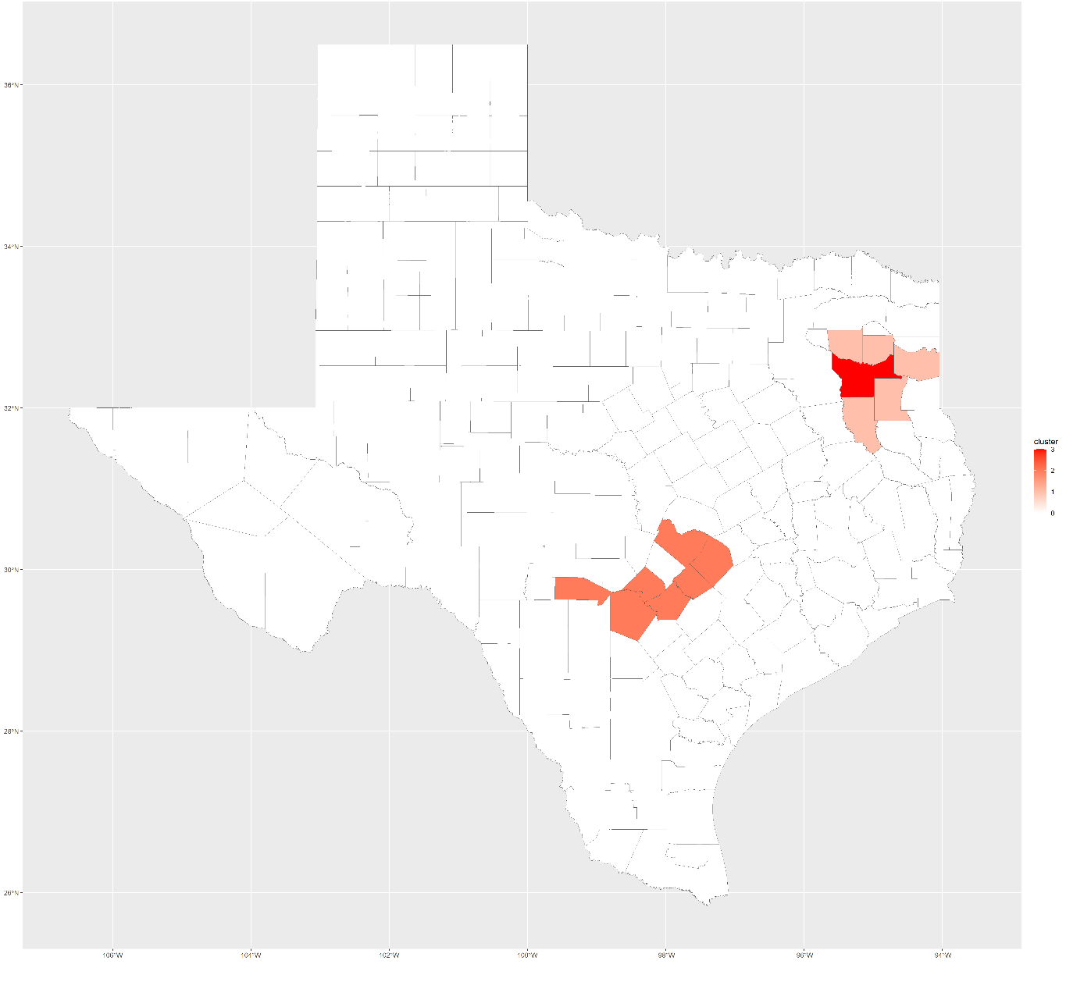
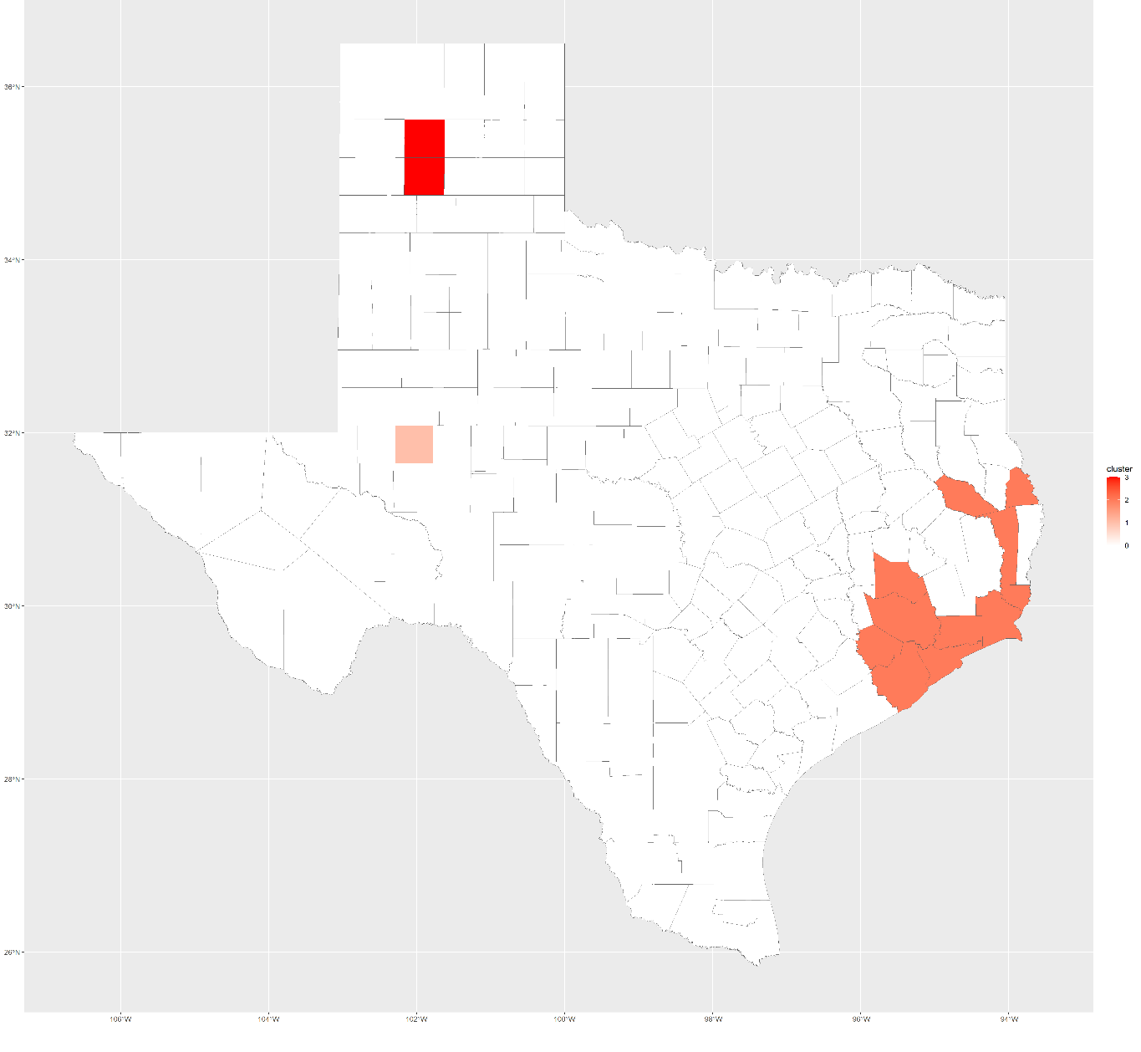
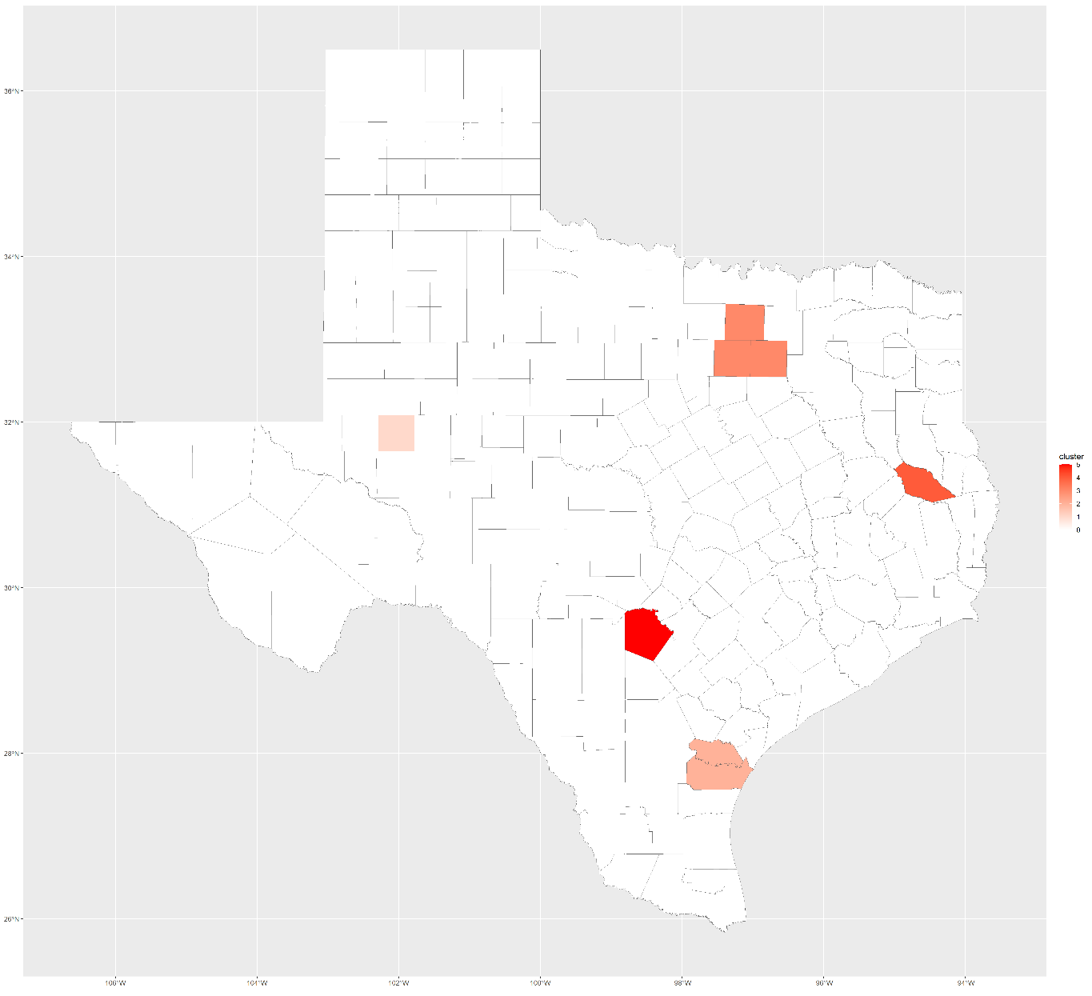
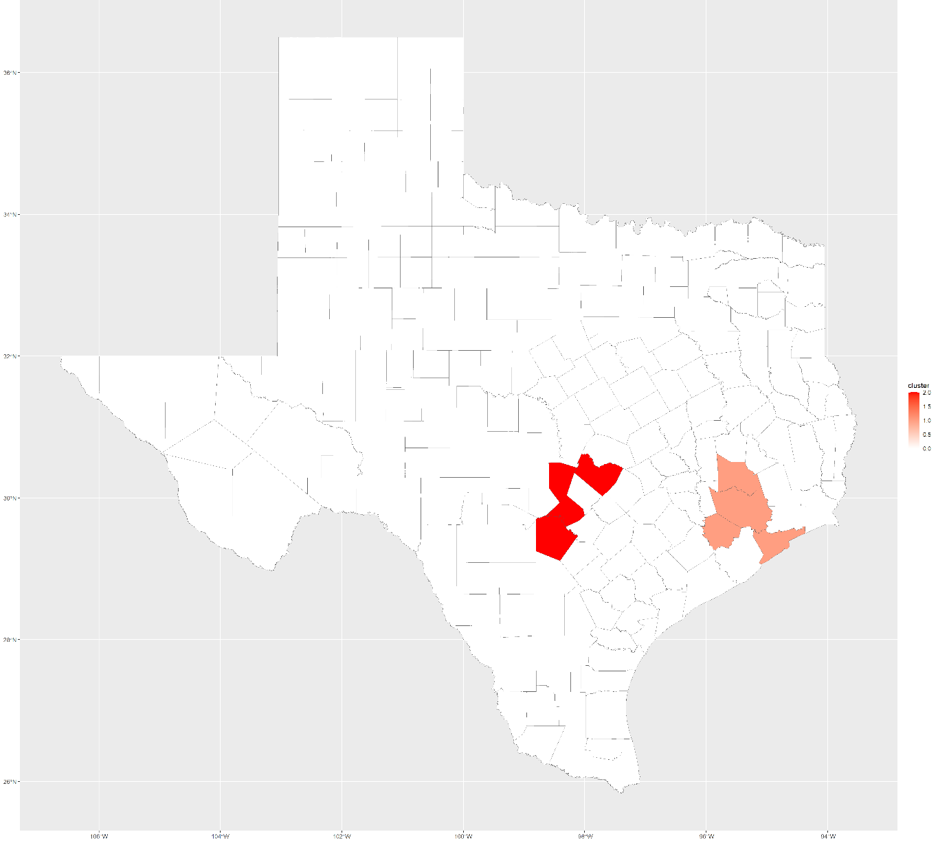
Flash Flooding
Motivation
Methodology
Results & Discussion
Conclusion
2010
2011
2012
2013
2014
2015
2016
2017
2018
2019

Slide 9
Flash Flooding
Motivation
Methodology
Results & Discussion
Conclusion
Counties most susceptible to Flash Flooding:
Bexar (San Antonio), Travis (Austin)
Comal
Midland, Smith and Gregg
In 2017, Greater Houston Area experienced significant flash flooding - Hurricane Harvey.
In 2015, Dallas Fort Worth Area experienced significant flash flooding - Tropical Storm Bill.

Slide 10
Flash Flooding
Motivation
Methodology
Results & Discussion
Conclusion
Spatio-temporal clustering important to:
Identify areas most susceptible to flash flooding: lead to perform analyses like causal, risk.
Investigate unusual patterns
Prepare better mitigation strategies (analyze neighboring areas with contrasting FF behavior).
Can be extended to identify census tracts/census blocks most susceptible to FF within counties - More targeted approach.
Limitation - robustness of analysis depends on NOAA Storm Events Database.

Slide 11
Thanks for your attention!

